Slide 1
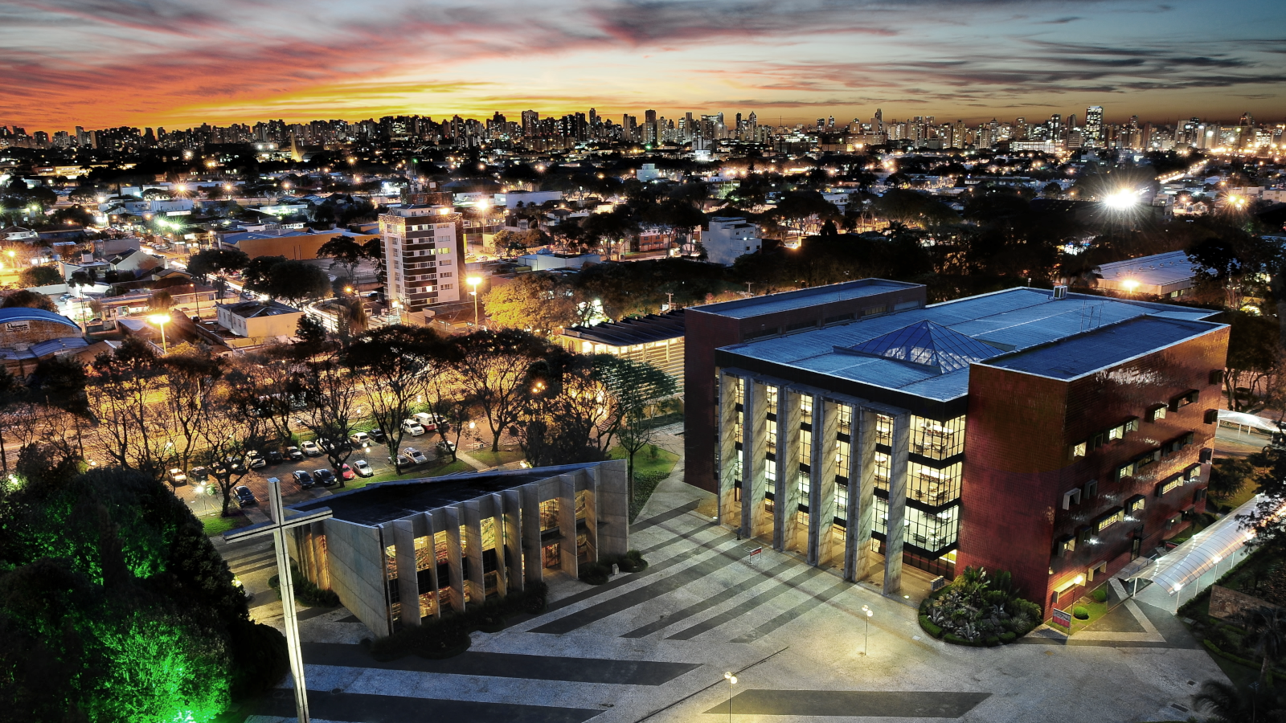
Mastering | Automation Journey
Wanderson Felipe Walger

Slide 2

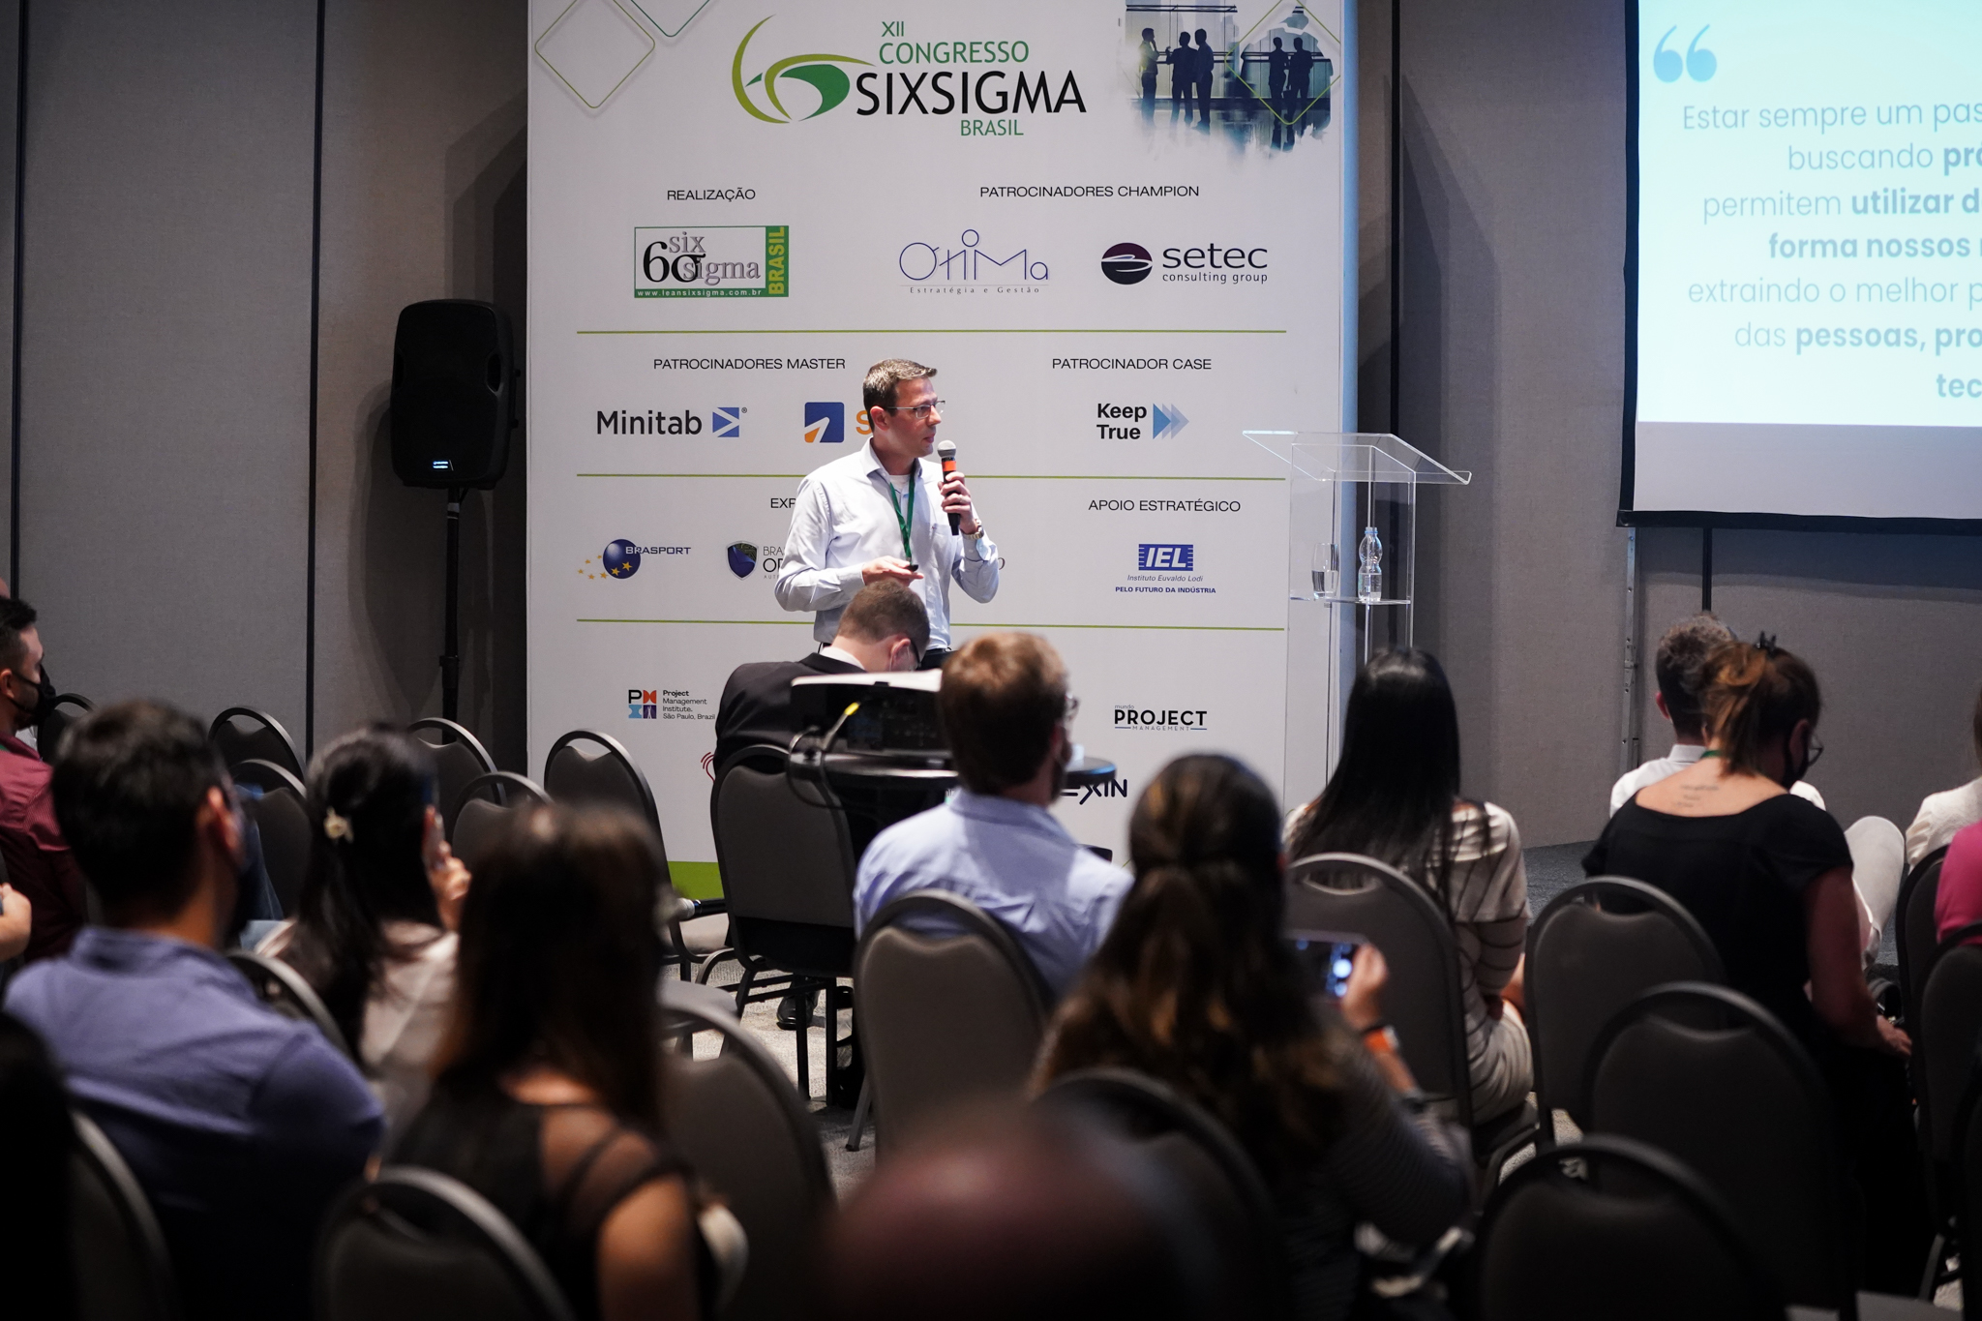










Pesquisar
Wanderson Felipe Walger
Transformação Digital | Melhoria Contínua
Gestão Processos | Excelência Operacional

Slide 3
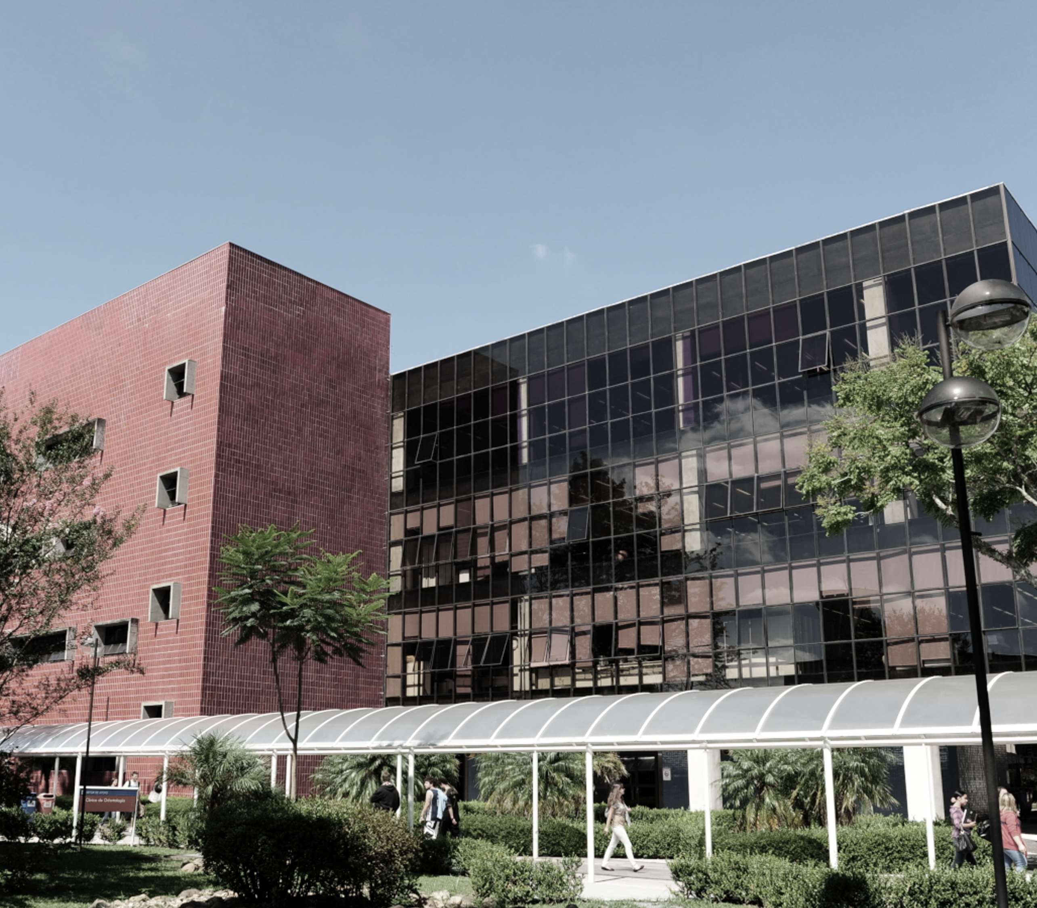

AGENDA
1
Institucional PUCPR
2
Transformação da Experiência
3
Resultados
4
Estudo de Caso
5
Q & A

Slide 4
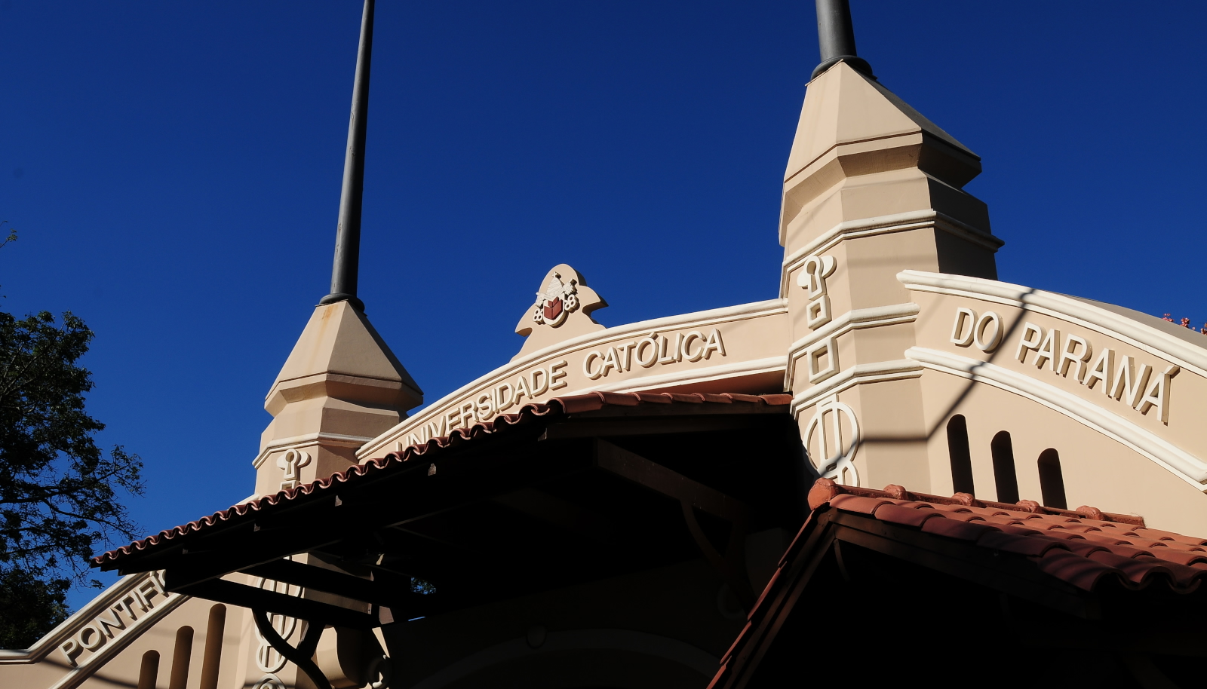
Institucional PUCPR

Slide 5
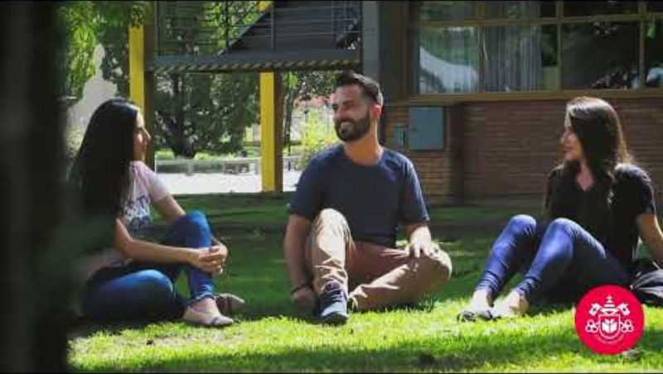

Slide 6

Sobre a PUCPR
Orientada por princípio éticos, cristãos e maristas, tem por missão desenvolver e difundir o conhecimento e a cultura e promover a formação integral e permanente dos cidadãos e profissionais comprometidos com a vida e com o progresso da sociedade.
+300
salas de aula
+230
laboratórios
+1.5k professores
+36k alunos

Slide 7


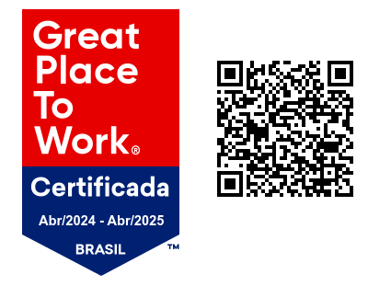

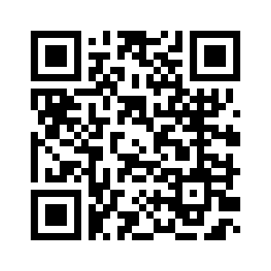


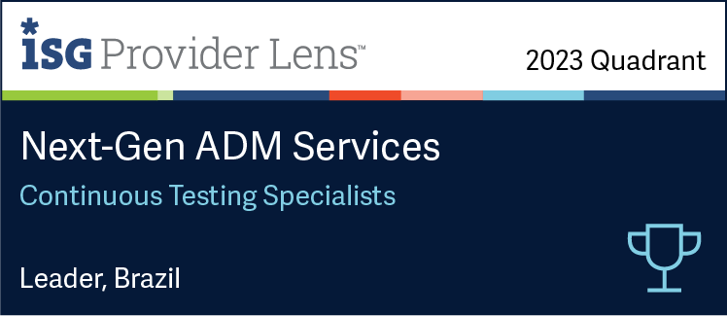

A Prime Control nasceu para fazer do mundo digital um lugar melhor, reunindo os melhores profissionais de testes e qualidade de software. Somos especialistas em testar e melhorar programas, apps, websites e integrações, garantindo boas experiências digitais para todos. Nossa filosofia é que a qualidade define os resultados, protegendo o sucesso dos projetos e assegurando a satisfação dos usuários finais.
SERVICES
Quality Services
Testes Contínuos, Consultoria de Qualidade, ERP, Performance, Farm, Crowd Testing e Code Quality
PMEs que mais crescem
no Brasil
IPA Services
RPA CoE, Process Automation, Sustentação RPA
DEM
Real User Monitoring, Synthetic Monitoring

Slide 8

Transformação da Experiência

Slide 9




Transformação
DA
EXPERIÊNCIA
Potencializar a execução da estratégia da instituição no caminho para uma organização ágil, inovadora e orientada ao cliente.
Excelência Operacional
Inovação e Tecnologia
Gestão Ágil de Projetos
Notes:
A gerência de TEX existe para Potencializar a execução da estratégia da instituição no caminho para uma organização ágil, inovadora e orientada ao cliente. Com 3 frentes de atuação:
Excelência Operacional, Inovação e Tecnologia, Gestão Ágil de Projetos

Slide 10
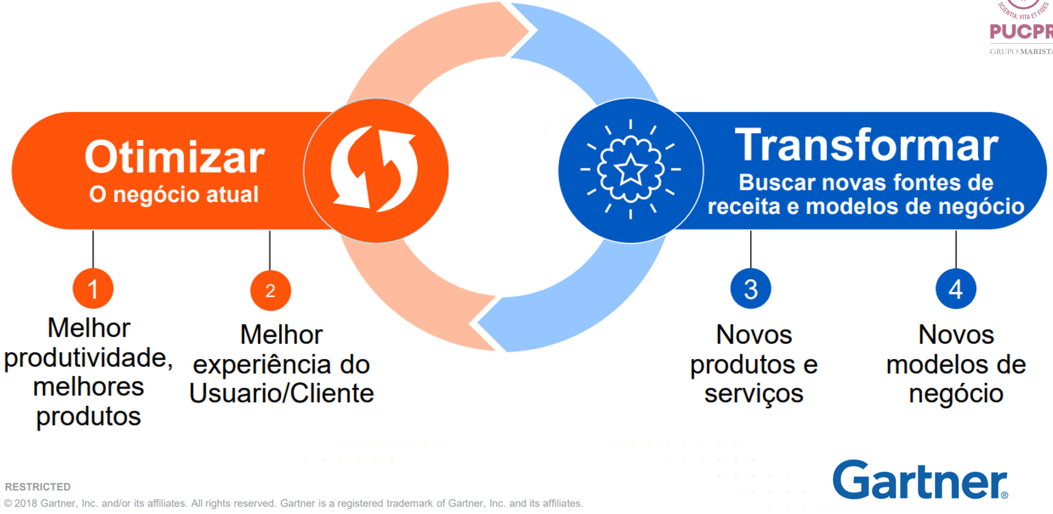
Ambição Digital

Slide 11






Matriz Decisão Transformação Operacional
AUTOMAÇÃO &
DIGITALIZAÇÃO
INOVAÇÃO
DISRUPTIVA
Transformação digital de processos
(RPA, OCR, IA, BPMS)
Soluções digitais disruptivas (inovação aberta, ecossistema de inovação hotmilk)
TECNOLOGIA
EXCELÊNCIA
OPERACIONAL
REENGENHARIA
PROCESSO
Melhoria contínua de processos e jornadas
(L6S, PDCA)
Redesenho e reengenharia de processos e jornadas (Design Thinking, Design Sprint, DFSS)
EFICÁCIA DO PROCESSO

Slide 12
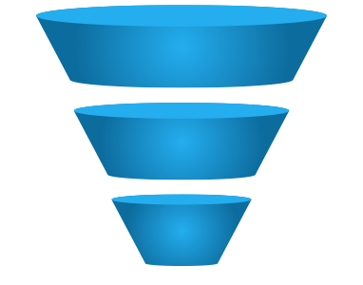
Framework Transformação Operacional
Oportunidade
Mapeamento
Solução
Implantação
Sustentação
.: Mapeamento AS IS
.: Refinamento
.: Coleta de dados
.: Análises
.: Desenho TO BE
.: Simplificação
.: Definição Tecnologia
Preparação Ambiente
.: Desenvolvimento
.: Q&A
.: Produção Assistida
.: Go Live
.: Monitoramento
.: Gestão de configuração
.: Incidentes
.: Suporte
Captura
Assessment
Priorização
Governança
Centro de Excelência | Gestão de Desempenho | Gestão de Mudanças | Gestão do Portfólio | Sustentação

Slide 13

Resultados

Slide 14

Resultados
Transformação Operacional
Números
+50
87%
100%
4.96
Projetos
Redução
Concordância
Satisfação
Projetos de Automações
Trabalho
Manual
Redução de
Esforço
Pesquisa de
Satisfação

Slide 15
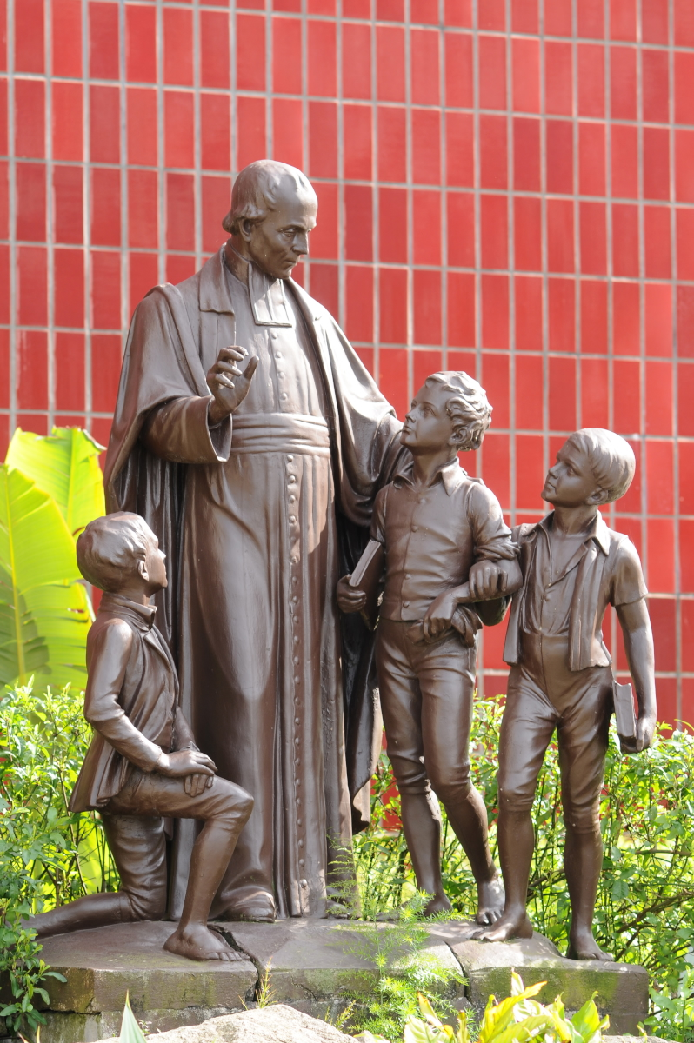



Excelência no Ensino
1ª Universidade
Privada do Paraná e
entre 3 melhores do país
1ª Universidade do Paraná em qualidade de pesquisa
Entre as Top 25%
da América Latina
15

Slide 16

Estudo de Caso

Slide 17

A method for prioritizing Robotic Process Automation (RPA) projects with the application of Multicriteria Decision-Making and Process Mining
Wanderson Walger¹, Eduardo Loures¹, Eduardo Portela²
PUCPR¹ UFPR²

Slide 18



ICPR Americas 2024 International Conference on Production Research
Athens, OH, USA
July 21 – 25, 2024
Intelligent Production and Industry 5.0 with Human touch, Resilience, and Circular Economy

Slide 19
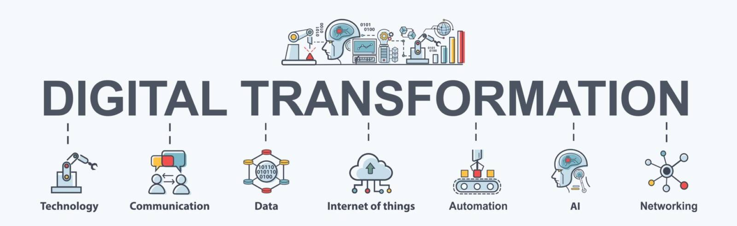
Robotic Process Automation as Key Enabler of Digital Transformation
A fundamental stage in the Digital Transformation journey is digitalization, where processes and information are converted into digital formats. Robotic Process Automation (RPA) is a valuable tool that supports this stage by automating repetitive tasks, thereby increasing efficiency and accuracy.

Slide 20




However, prioritizing RPA projects is not trivial
How to select and prioritize process to automate?
...to ensure efficiency, effectiveness, scalability, and a good return on investment…

Slide 21
An alternative solution to this problem
A method that integrates Multiple Criteria Decision-Making and Process Mining
Multiple Criteria Decision-Making
Process
Mining
A field of study and a set of techniques used in decision science and operations research to evaluate and choose the best alternative from a set of available options.
A field of data science that involves analyzing event data logs generated by software systems to discover, monitor, and improve real processes.

Slide 22


Selecting RPA Opportunities by Integrating MCDM and PM
The integration of MCDM and PM offers a potent strategy for selecting RPA projects
Together, these approaches enable organizations to systematically prioritize RPA opportunities, driving efficiency and innovation while mitigating risks.
Related Work

Slide 23
Background
ROBOTIC PROCESS AUTOMATION (RPA)
A technology focused on automating repetitive, routine, rule-based human tasks.
MULTIPLE CRITERIA DECISION MAKING (MCDM)
Involves addressing decision problems that go beyond simple choices among well-defined alternatives.
ANALYTIC HIERARCHY PROCESS (AHP)
The AHP is a widely used ranking method in MCDM contexts. Analyzing decision problems through a hierarchical structure, the AHP breaks down intricate issues into manageable subproblems, featuring a goal, criteria, and alternatives.
PROCESS MINING (PM)
It focuses on understanding processes and provides significant findings from process execution event logs. The main stages of process mining include discovery, conformance, and enhancement.

Slide 24
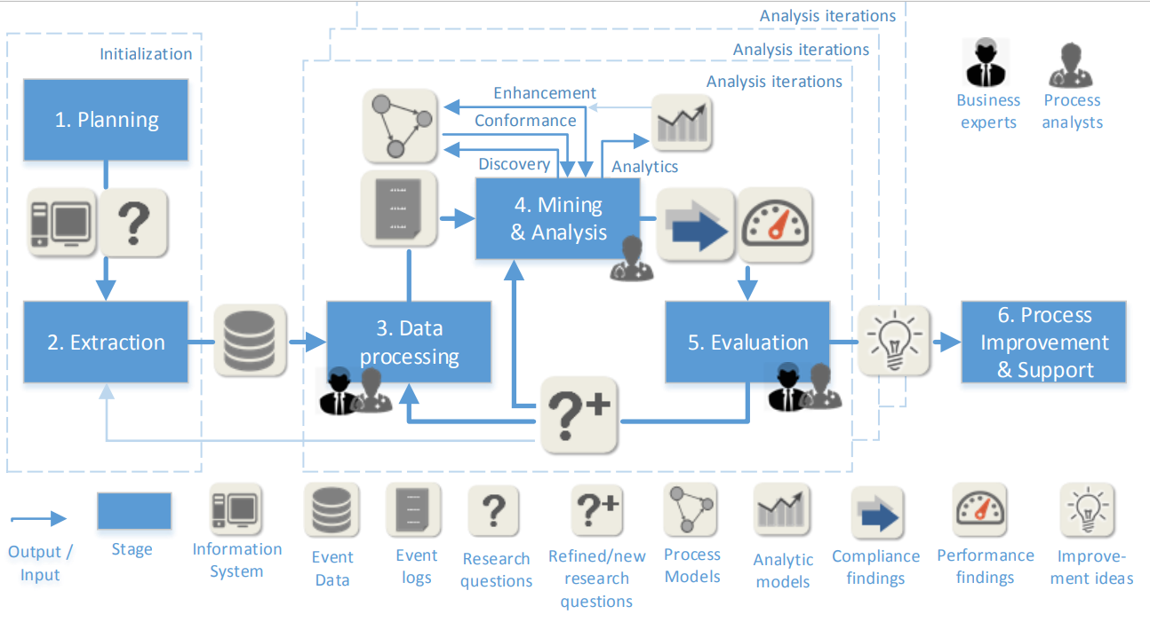
PM²: A Process Mining Project Methodology

Slide 25
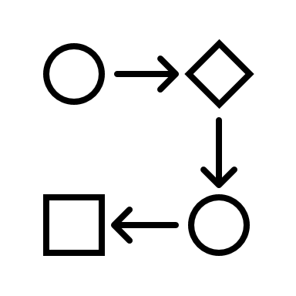













PM²: A Process Mining Project Methodology
1. Planning
2. Extraction
3. Data Processing
Define the key issues of the project
Extract data
Create event log
1.1 Select the Process
1.2 Define key question
1.3 Build the team
2.1 Define the scope
2.2 Extract the data
3.1 Correct the data
3.2 Organize data
3.3 Apply filters
MCDM: Multicriteria Decision-Making
4. Mining and Analysis
5. Evaluation
6. Improvement
Perform analysis and mining the process
Define Actions
Transform the process
4.1 Statistical Analyzes
4.2 Process Mining
4.3 RPA Analyzes
5.1 Diagnosis
5.2 Verification and Validation
6.1 implement the actions
RPA

Slide 26










Case Study
Case Study
The case study was implemented in the support services department of a private Brazilian University.
The support services offer guidance on academic matters, enrollment procedures, and other student-related services, ensuring a smooth academic experience.
Student
Customer
Suport

Slide 27
1.1 Select the process using the AHP application, an MCDM method
Select the process
OBJECTIVE
6%
22%
50%
13%
8%
Level 2
CRITERIA
Complexity
Data Structured
Frequency
Digital Data
Rule Based
Level 3
33%
13%
12%
30%
12%
ALTERNATIVES
Academic
Transcript
document
Cancellation
of
Enrollment
Requesting enrollment freeze
Registration
certificate
document
Change of class,
course, shift,
campus

Slide 28

1.2 Define the Key Question
Which activities can be automated, and which should be performed by humans?

Slide 29


1.3 Building the Team
Process
Owner
Business
Analyst
Database
Analyst
RPA
Developer
Data
Scientist

Slide 30
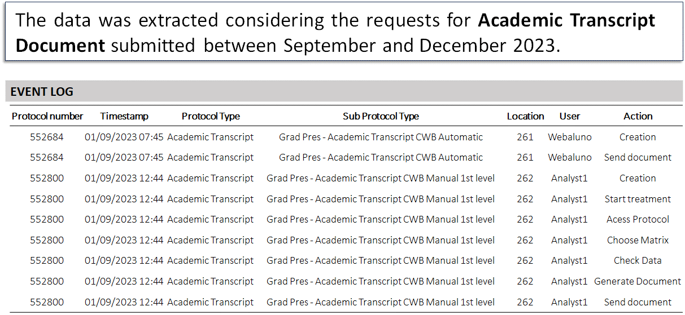
2. Extraction

Slide 31
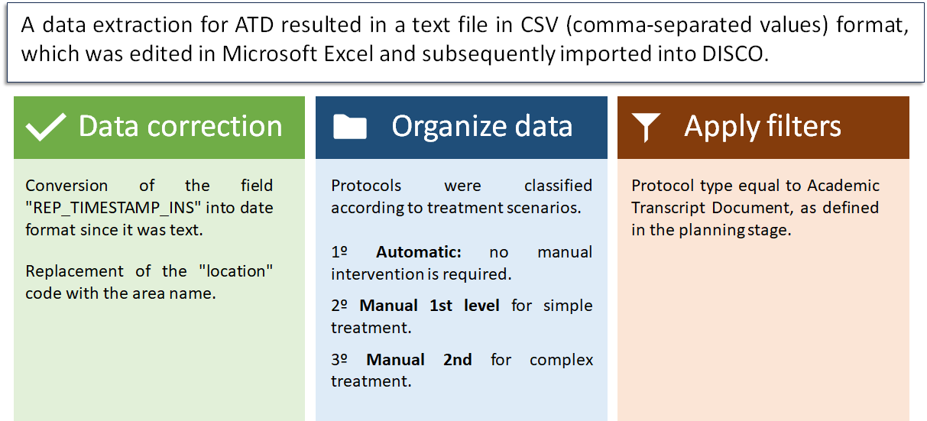
3. Data Processing

Slide 32
4.1 Statistical Analyzes
General data
Resources
12.726 Events
5.658 Cases
4h average duration
Requests per month
Treatment Scenarios
Responsible areas

Slide 33
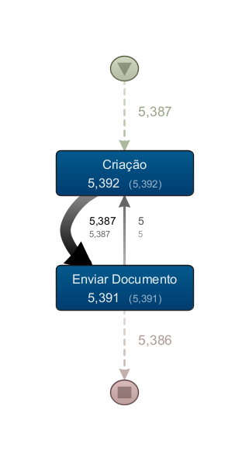
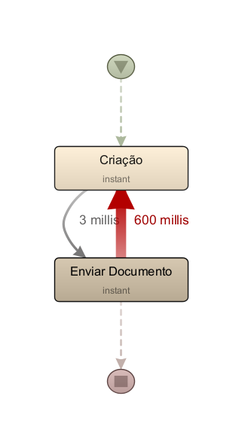
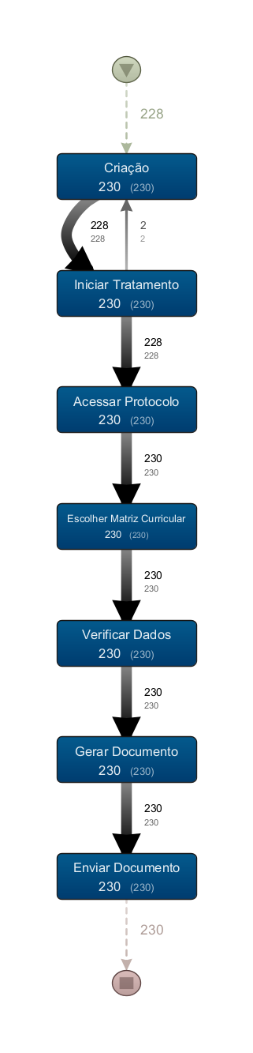
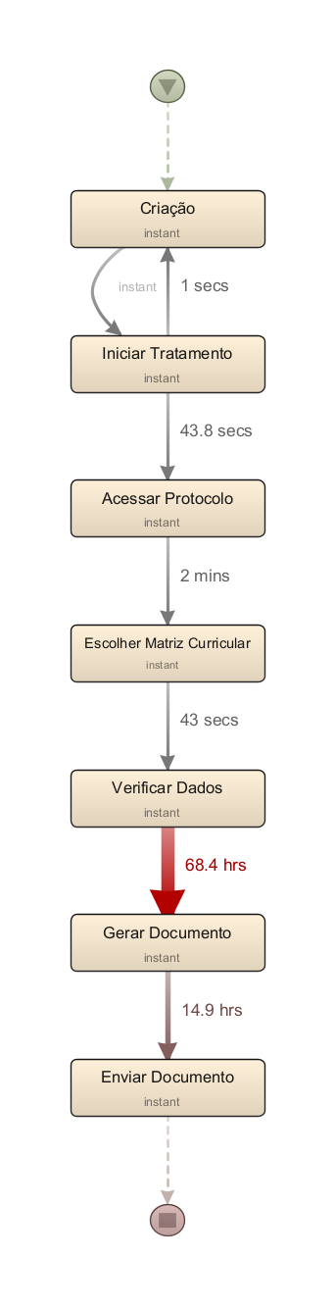
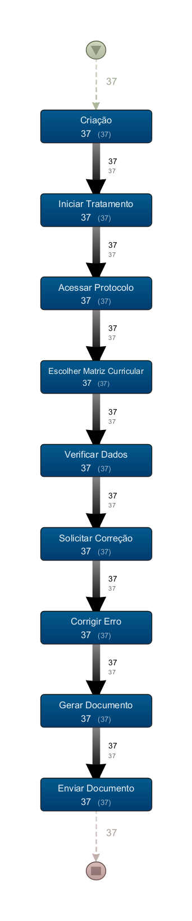
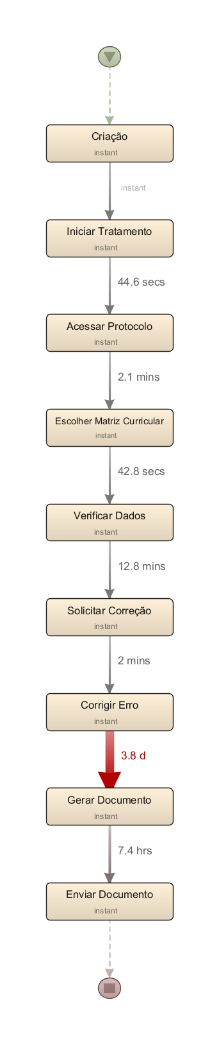
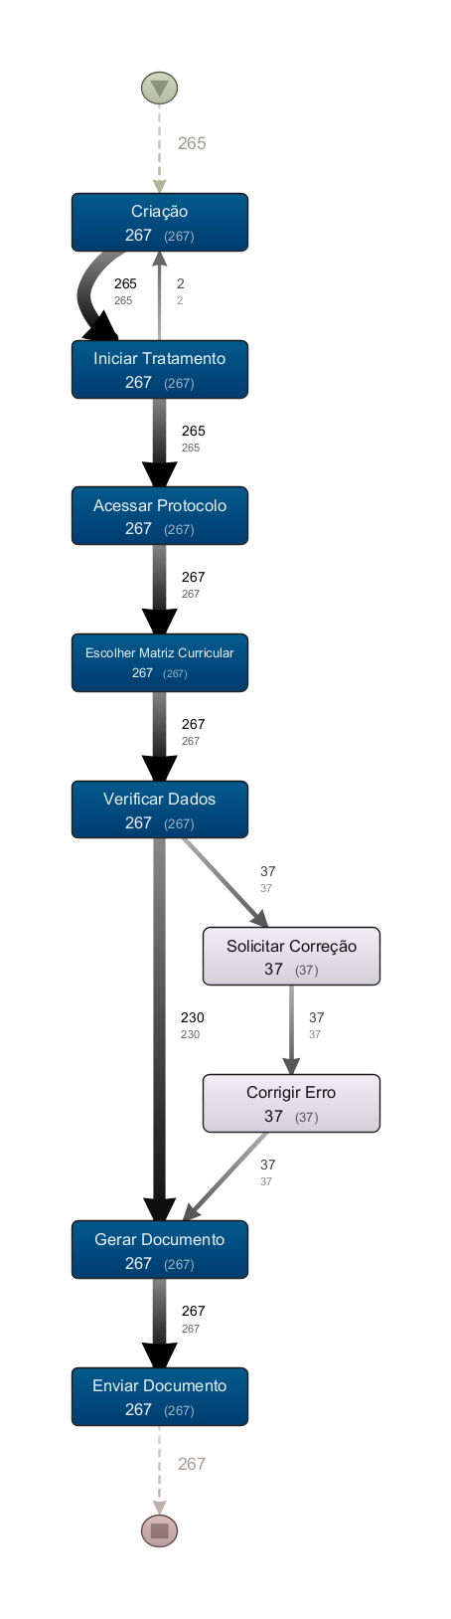
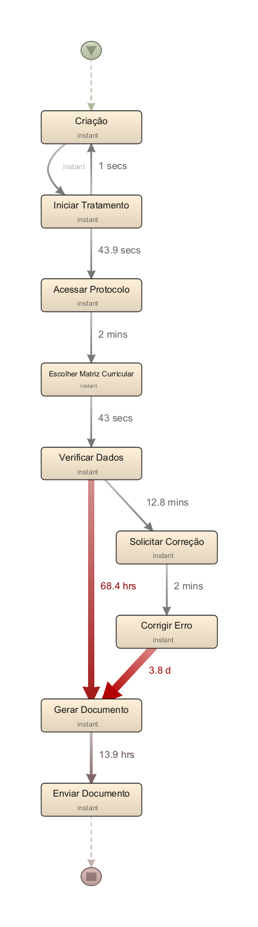
4.2 Process Mining
Automatic
Manual
Manual 1st Level
Manual 2nd Level
Frequency
Performance
Frequency
Performance
Frequency
Performance
Frequency
Performance

Slide 34
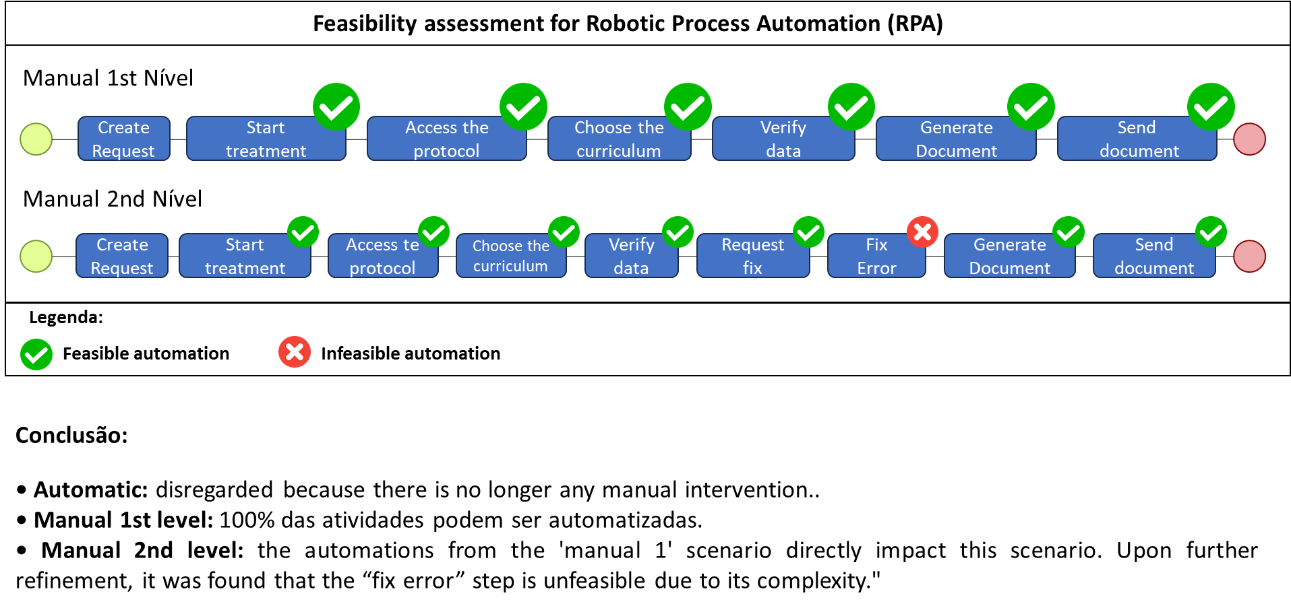
4.3 RPA Analyzes
Manual 1st Level
Manual 2nd Level
Conclusion:

Slide 35


5. Evaluation
5.1 DIAGNOSIS
The analyses showed a significant difference between the types of treatment, indicating that steps marked as 'feasible for automation' should indeed be automated.
5.2 VERIFICATION AND VALIDATION
The verification and validation of ATD were presented to the stakeholders, and there was a consensus that the suggestions can be implemented.

Slide 36

6. Process Improvement
Action Plan
This stage is currently underway, with two planned activities.
1. Develop the business case, a rationale for a proposed investment.
2. The process owner will assess the availability of financial resources for the implementation.

Slide 37

Final Consideration
The benefits of the method for prioritizing RPA projects with MCDM and PM
The methodology presented a didactic, structured routine and facilitated the application.
Reduction of subjectivity in the process of assessing automation potential.
Involvement of technical and business personnel.
Speed of implementation.

Slide 38






Wanderson Felipe Walger
Decision Making, Robotic Process Automation, Process Mining
wfwalger@hotmail.com
wanderson-felipe-walger
@wfwalger
+55 41 99941.0093

Slide 39
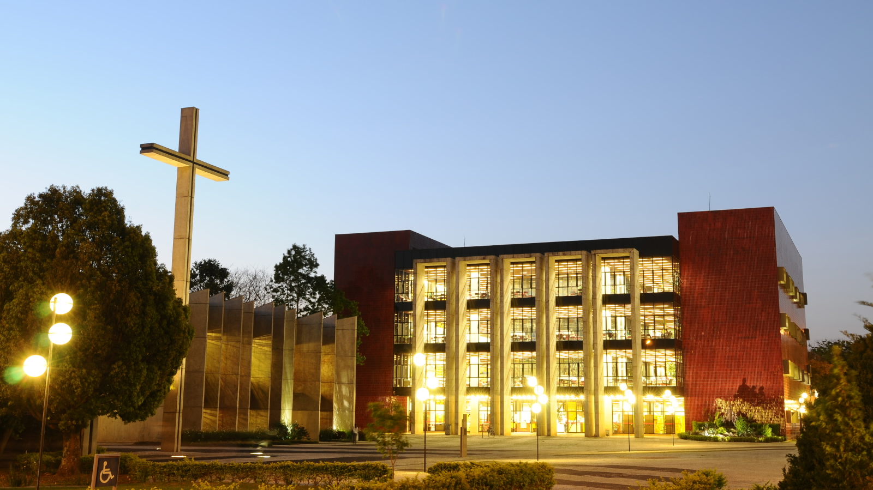
Q&A

Slide 40
Mastering | Automation Journey
Wanderson Felipe Walger

